Slide 1


StableMate:
a regression framework for selecting stable predictors across heterogeneous data environments
Yidi Deng (Melbourne Integrative Genomics)
Supervised by:
Prof. Kim-Anh Lê Cao
Dr. Jarny Choi
Dr. Jiadong Mao
Notes:
So I’m Yidi Deng, and today I’m goanna talk about StableMate, which we developed a regression framework for selecting stable predictors across heterogeneous data environments, this work was done during my PhD at the University of Melbourne, but now I just fished and goanna start at the Australian National Univeristy.

Slide 2
Motivation
Inferencing biological variables relationships
Notes:
Lets first talk about the motivation. Though StableMate is a variable selection method, but it is motivated by the inference of biological variables relationships in system biology. So what are these relationships

Slide 3
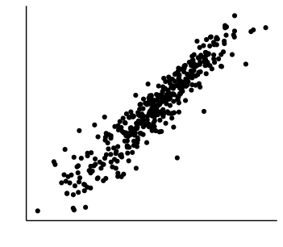
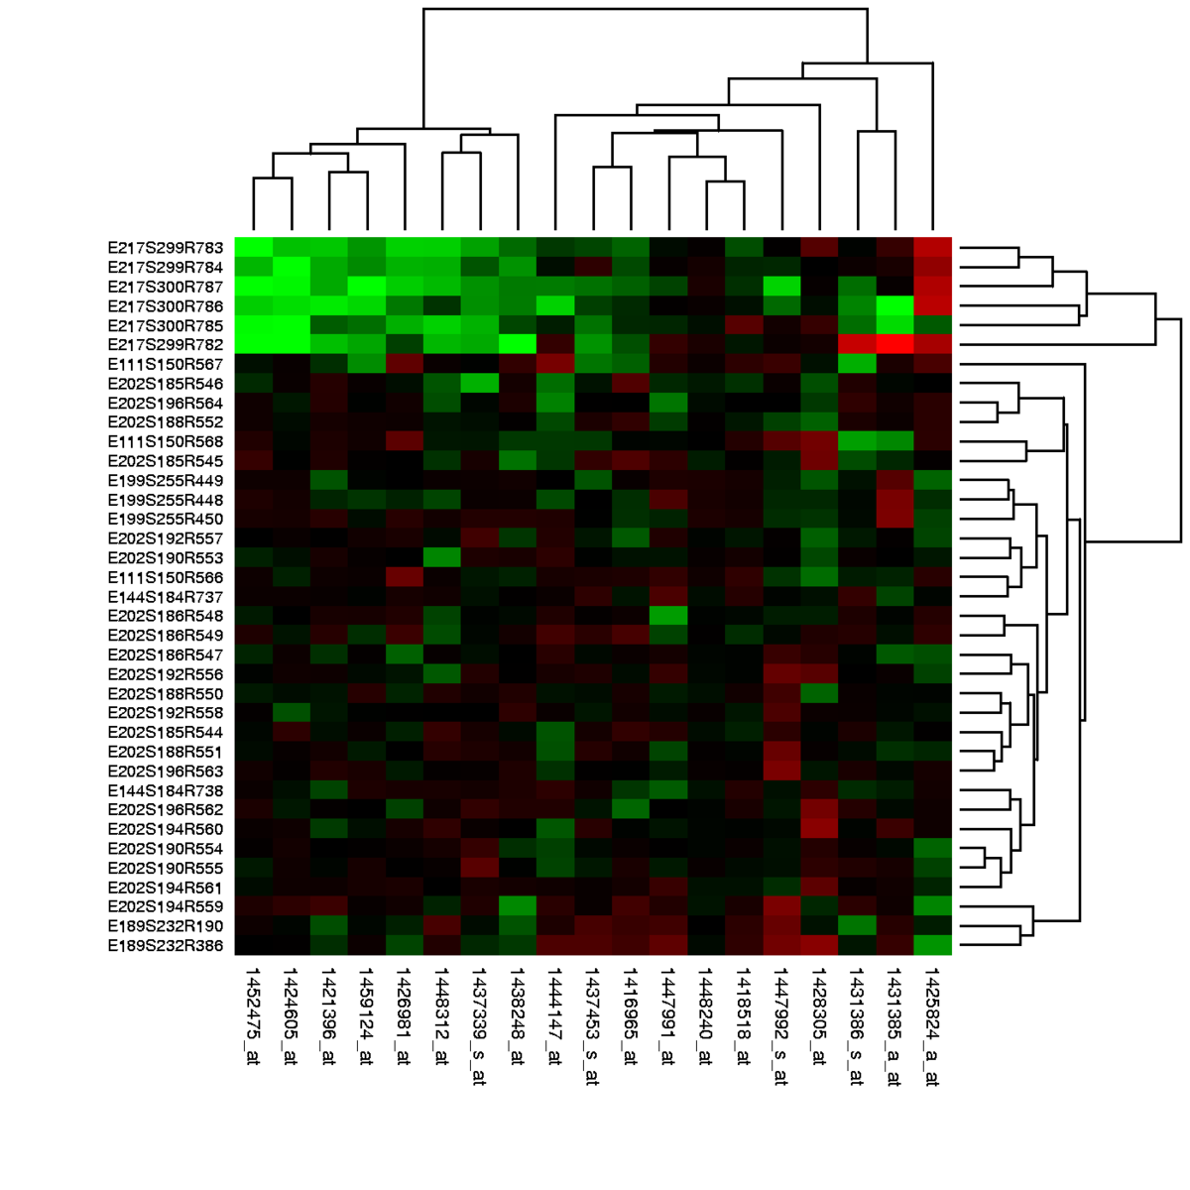
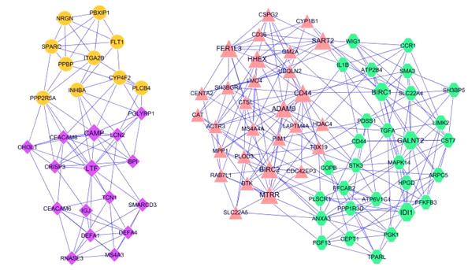
Example: gene regulatory network
Gene B
Gene A
Gene expression data
Network
Retrieved from https://en.wikipedia.org/wiki/Gene_expression_profiling
Retrieved from https://www.ese.wustl.edu/~nehorai/research/genomic/grn.html
Notes:
One typical type of such relationship is gene regulation, which is the process where the expression of one gene control that of the other. And the statistical method that infer gene regulation will take gene expression data as an input, and output a network with nodes representing genes and edges representing inferred statistical association between the gene expression, which can correlation, dependency, and causality, or what every you what.

Slide 4
Limitation of current methods
Lack of interpretability:
?
Statistical association
Biological hypothesis for validation
2. Lack of generalizability:
?
Study1
Study2
Benchmark studies: Marbach et al.,2010, Bellot et al., 2015, Chen and Mar, 2018, Pratapa et al., 2020, Nguyen et al., 2021, Kang et al.,2021
Notes:
However, from our practical experience as well as the benchmark study over the time, we found that the current method suffers common pitfall of lack of interpretability and generalizability. For interpretability we concerns whether the inferred statistical association can be meaningfully translated into biological hypothesis for validation. For generalizability, we simply concerns whether the result we got from the first study can be reproduced in another study.

Slide 5

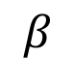
Stable association
Robust to perturbation
Generalizable
Perturbation
$$β$$
X1 X2
2. Causal implication
Interpretable
Bühlmann, P. (2020). Invariance, causality and robustness.
Notes:
This motivates us to infer a special type of association called stable association. Briefly speaking, stable association is the association that are robust, or stay consistent when data is subject to external perturbation. Stable association is good because its robustness is an intrinsic guarantee of generalizability. Moreover, stability has causal implication, since causality is a physical law that is stable in nature So how do we infer stable association?

Slide 6
The theoretical framework of stabilised regression (Pfister et al. 2021)
Notes:
The theoretical framework of stabilised regression proposed by Pfister in 2021 draw our attention, and this where the StableMate is build based on.

Slide 7
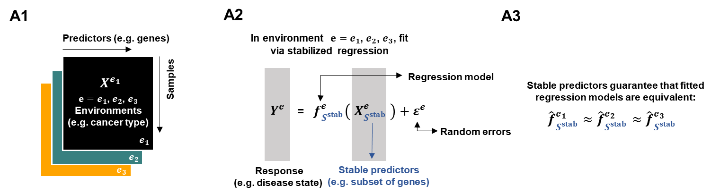
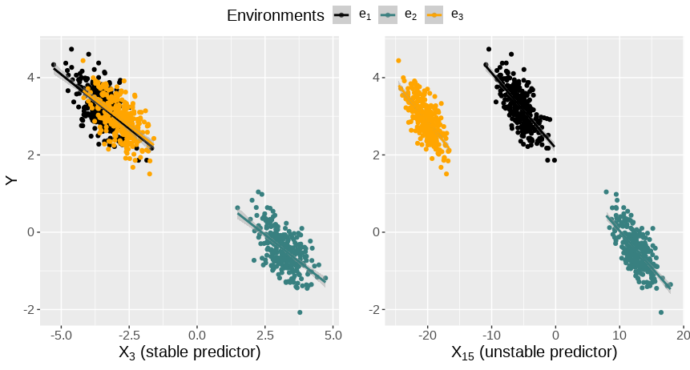
Goal of Stabilised Regression (SR)
Infer generalizable functional dependency on the response
Pfister, N., (2021). Stabilizing variable selection and regression
Notes:
It assumes a multi-environment regression setting where datasets are collected from different physical or biological conditions, which we referred to as environment. Its goal is to identify a set of stable predictors whose regression relationships with a response are consistent across environments. The procedure of selecting stable predictors can be considered as capturing generalizable functional dependency on the response. These plots compare stable and unstable predictors: the stable one shows consistent linear association across environments, while the unstable one does not.

Slide 8
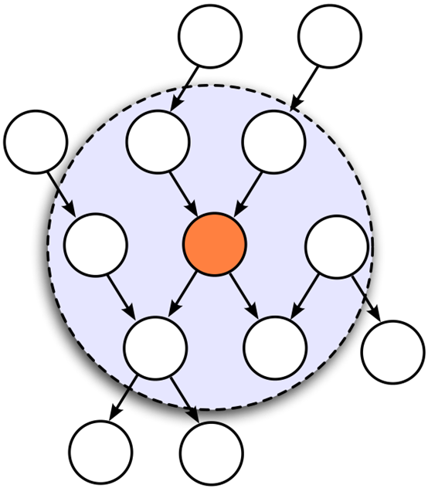
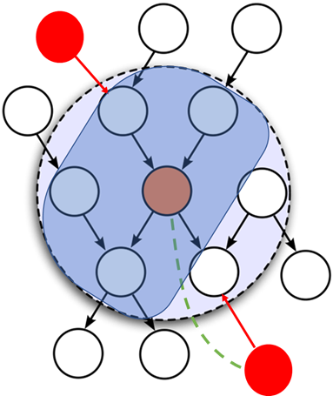
Markov Blanket and Stable Blanket
MB: The most predictive set
SB: The most predictive stable set
SB
MB
Environmental
intervention
PA <= SB <= MB
Notes:
Formally, the set of predictor that stabilized regression intends to infer is called the stable blanket, which is a concept derived from the Markov blanket in structural causal model. For example, this graph represents a causal structure and each node represents a variable, let the orange node be the response, then the Markov blanket is the smallest set of variable condition on which renders the response independent from the rest of the variable. MB is the best set of predictor for predicting the response. Now,we consider that the system is exogenously perturbed by some intervention variable that represent environment effect, MB’s prediction can be confounded by the intervention, since it establish the dependency between the intervention and the response in this case. A set whose prediction on the response is not influenced by the intervention is called a stable set, and the stable blanket is the most predictive stable set. When there is no intervention SB equals to MB. When there is sufficient intervention SB equals to the causal parents.

Slide 9
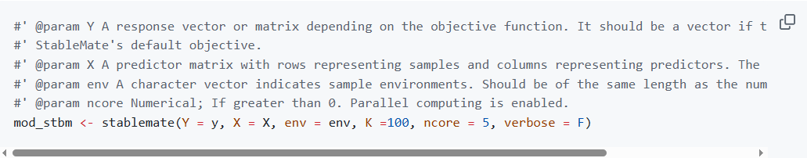
StableMate select MB and SB
Usage
All you need to provide are, response, predictor data, and sample environments
Notes:
Of couse the goal of StableMate is to Markov blanket and stable blanket based on observational data, and before we dive into the details of the algorithm, I want to first give you a teaser on how the method should be used and how its result looks like. Here is one line code of the usage, which is so simple. You just need to provide a response vector, a predictor matrix, and a factor indicating each samples environment.

Slide 10
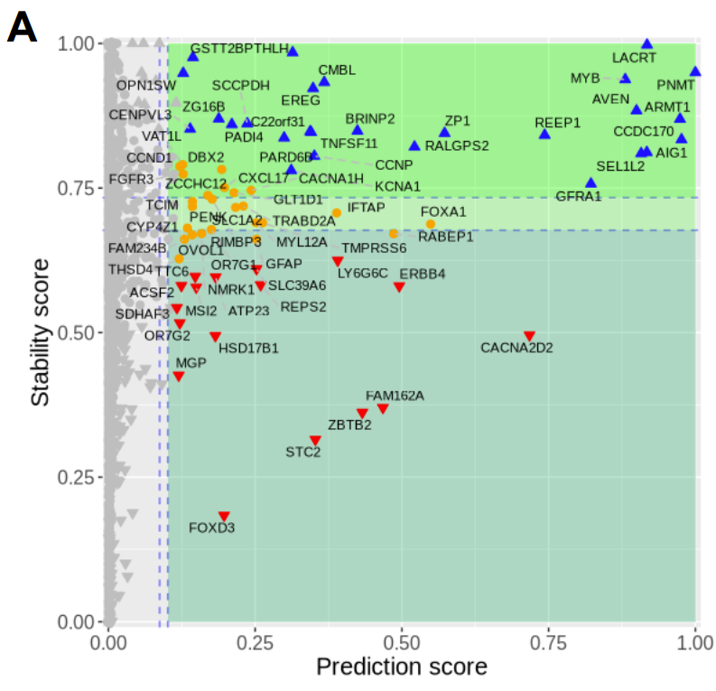
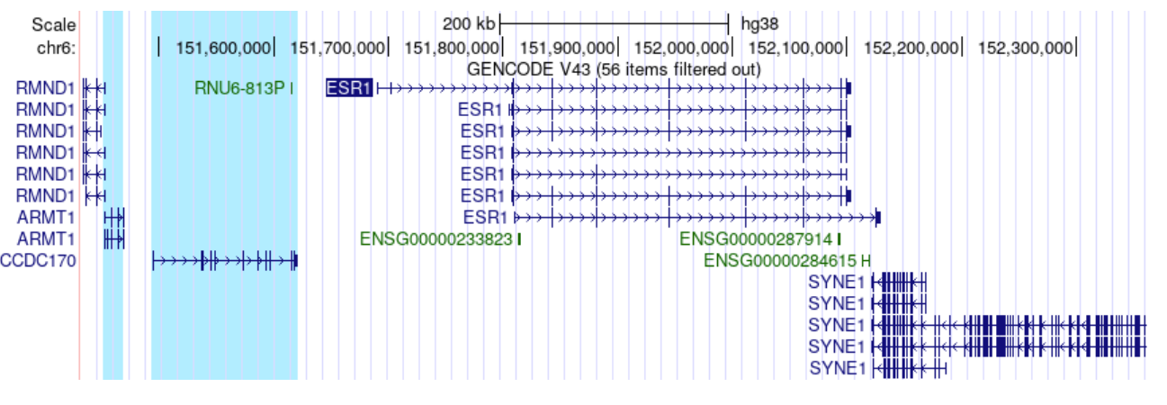
StableMate output
The Cancer Genome Atlas Program breast cancer gene expression
Stable gene predictors of Estrogen Receptor 1 (ESR1) expression across disease conditions
ARMT1 and CCDC170 may subject to the same transcriptional regulation as ESR1
Notes:
To show you the StableMate output, I use the cancer genome atlas program breast cancer gene expression data as an example, and goal here is to infer this estrogen receptor 1 expression across disease condition. The output of StableMate is a variable selection plot. Each point represents a predictor that is assigned a prediction and stability score. Those are colored are predictive and we say belongs to the Markov blanket. The blue ones are stable and predictive and belongs to the stable blanket, and the red ones are unstable. If we look at those genes that are selected as are selected as most predictive and stable, we would expect that they have a close regulatory relationship with ESR1. For example, if we look at this ARMT1 and CCDC170. We track that these genes are located right next to ESR1 at its upper genomic region, suggesting that hey will share a similar regulatory program as ESR1.
, where each points corresponds to a gene. The genes I marked in circle are the genes that are most stable and predictive of ESR1 expression, and hence more likely to be proxy ESR1 regulation. For example, we examined ARMT1 and CCDC170, are found to be located closeted to the upper genomic region of ESR1, hence support that they may subject to the same transcriptional regulation.

Slide 11
StableMate (Deng et al. 2023)
Deng, Y., Mao, J., Choi, J., & Lê Cao, K. A. (2024) NAR Genomics and Bioinformatics
Notes:
Now lets talk about the StableMate algorithm.

Slide 12
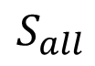
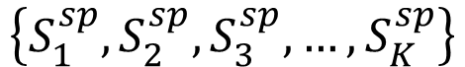
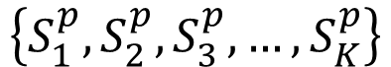
StableMate algorithm
StableMate is an ensemble approach, whose selections are made a stochastic selector (ST2).
$$S_{all}$$
SB must be the subset of MB
ST2: select predictive sets
$$\left\{S_{1}^{p},S_{2}^{p},S_{3}^{p},…,S_{K}^{p}\right\}$$
$$S_{k}^{sp}⊆S_{k}^{p}$$
ST2: select stable and predictive sets
$$\left\{S_{1}^{sp},S_{2}^{sp},S_{3}^{sp},…,S_{K}^{sp}\right\}$$
Notes:
In general, StableMate use an ensemble approach to make selections, and the ensemble is build by a stochastic selector (ST2). If you run a stochastic selector for multiple times on the same data, it will give different result. StableMate selection is a two stage procedure, in the first stahe it will run ST2 to search among all predictors to search for predictive sets, and builds an ensemble of random selection. Then due to the fact that stable blanket must be a subset of the Markov blanket, we the run ST2 within each predictive set to select a stable and predictive sets.

Slide 13
Stochastic Stepwise (ST2) Selection
Overcome the local optima issue of the classical stepwise selection
Fit regression model.
Randomly subsample some predictor sets.
Add or remove one set per step
Stop until no improvement.
Enlarged search space, increase the variability of selection
Xin et al. 2012
Notes:
So the full name of ST2 is stochastic stepwise (ST2 selection. As its name suggests, ST’s algorithm that is to very similar to classical approach stepwise selection that we all know but it can greatly overcome the well known local optima issue of the classical approach. It still makes selection in a stepwise manner to optimize a regression model evaluated by some objective functions. But instead of adding or removing one predictors from the model at each step, ST2 first randomly subsampled some predictor sets as candidates, from which it then select the best set to add or remove. This greatly enlarge the search space.

Slide 14
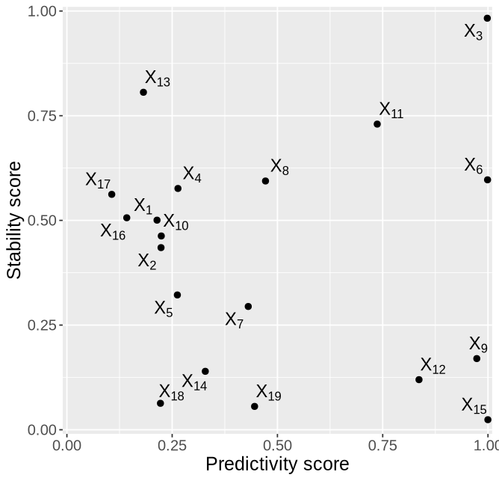
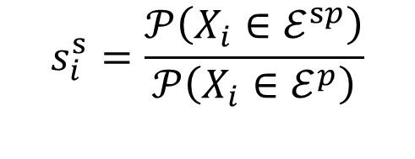
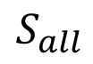
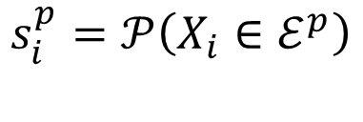
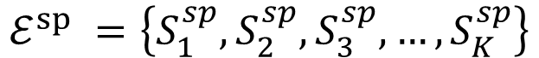
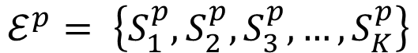
Objectives
$$S_{all}$$
ST2: minimize BIC
$$ℰ^{p}= \left\{S_{1}^{p},S_{2}^{p},S_{3}^{p},…,S_{K}^{p}\right\}$$
ST2: optimize cross validation performance (MSE) across environments
$$ℰ^{sp} =\left\{S_{1}^{sp},S_{2}^{sp},S_{3}^{sp},…,S_{K}^{sp}\right\}$$
$$s_{i}^{s}=\frac{𝒫\left(X_{i}∈ℰ^{sp}\right)}{𝒫\left(X_{i}∈ℰ^{p}\right)}$$
Calculate selection frequency
$$s_{i}^{p}=𝒫\left(X_{i}∈ℰ^{p}\right)$$
Prediction score
Stability score
Notes:
The objective function for selecting predictive sets is Bayesian information criterion. Under structure causal model assumption, the set that minimize BIC approximate the Markov blanket. Add for selecting stable set, we choose to minimise cross validation error with data being partitioned by environment. It is a very simple and intuitive objective, but it has a nice property that when there is no environmental effect, it is guaranteed that the stable and predictive set equals to the predictive set. Finaly, we calculate selection frequencies of predictors in each of this ensemble to obtain stability and prediction scores.

Slide 15
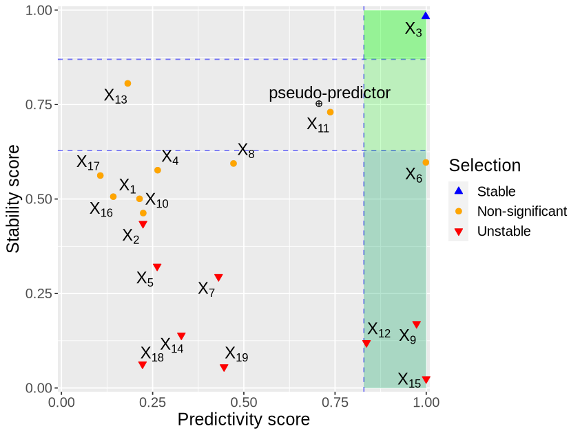
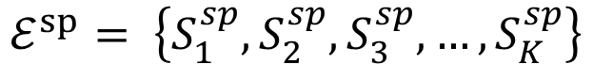
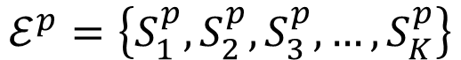
Make selection
Add a pseudo-predictor
(Can be selected but doesn’t influence model fitting).
$$S_{all}$$
Predictive and stable
$$ℰ^{p}=\left\{S_{1}^{p},S_{2}^{p},S_{3}^{p},…,S_{K}^{p}\right\}$$
$$ℰ^{sp}= \left\{S_{1}^{sp},S_{2}^{sp},S_{3}^{sp},…,S_{K}^{sp}\right\}$$
Calculate selection frequency
Predictive but unstable
Notes:
In order to make a final selection, that is finding a decision threshold, we add a pseudo-predictor to the predictor pool. A pseudo predictor is a predictor that can be selected but doesn’t influence the model fitting. Hence, if a predictor is selected more often than the pseudo predictor in the prediction ensemble , then it is more likely to be truly predictive. Similar rule applies to the stability selection. Then we got the final selection plot.

Slide 16
Simulation study
Notes:
Of course we want to know whether the stable predictors we selected actually aligned with the underlying stable blanket, hence we conduct a simulation study.

Slide 17
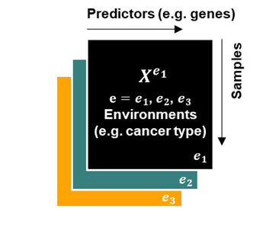
Setting
Simulate a structural causal model (SCM) in different environments
Generate data according to the SCM
(Three training, one testing environment)
Mask the SCM
Identify SB from observational data
Differs by exogenous perturbation
Notes:
Our simulation is based on the theoretical assumption of stabilized regression that data is generated under a structure causal model. Therefore, for each simulation run, we first generate a causal graph like this. Data will be generated according to the causal ordering of the graph. Data in different environment shares the graph, but differs in the distribution of the exogenous perturbation. This shift of distribution represents the environment effect. We simulate four environments and each environment we will get a data matrix with the same set of variables. We then mask the SCM and hope to recover the stable blanket from the observational data.

Slide 18
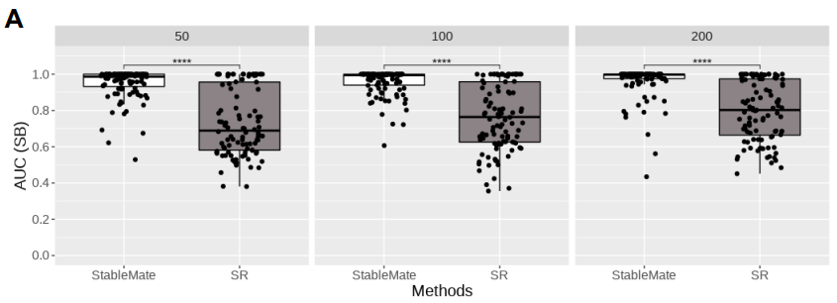
StableMate makes better selections
Notes:
We simulated systems of three different sizes, containing 50, 100 and 200 predictors. For each scenario we repeated simulation for 100 times. StableMate here is compared with original stabilized regression in their AUC score in recovering the stable blanket. We can see that in all senarios, stablemate makes better selection

Slide 19
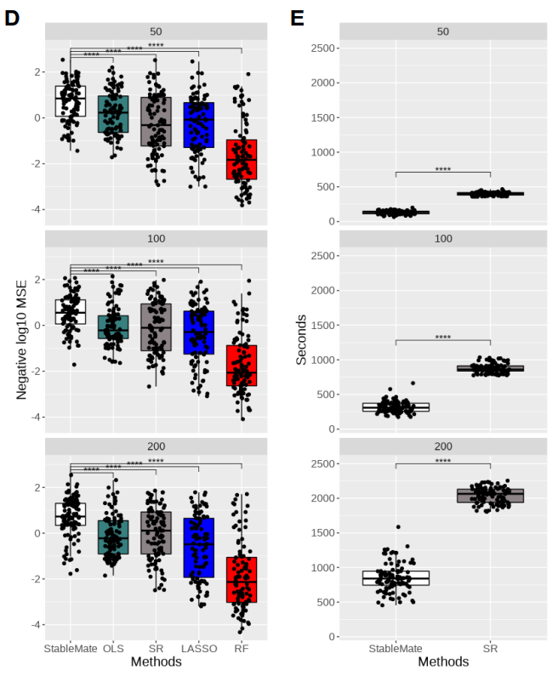
Train in three training environments
Test in the fourth environment
StableMate extrapolate better,
with greatly reduced running time
Notes:
Note that we should also expect that the regression model build with stable blanket would have better extrapolation performance. To show that, for each simulation run we split the four environments three into training regression model sand one for testing prediction performace. StableMate is compared with the stabilized regression, as well as other prediction models. We show the negative of mean squared error obtained in the test environment as the y axis here. Apparently, stablemate achieved the best performance. Moreover, all these improved selection and prediction accuracy of stablemate is coming with greatly reduced running time compared to stabilized regression.

Slide 20
We don’t have to restrict our definition of biological variables (Revisiting the breast cancer data)
Notes:
Finally, I want to conclude the talk by going back to the breast cancer data shown at the beginning of the talk, just to demonstrate that We don’t have to restrict our definition of biological variables.

Slide 21
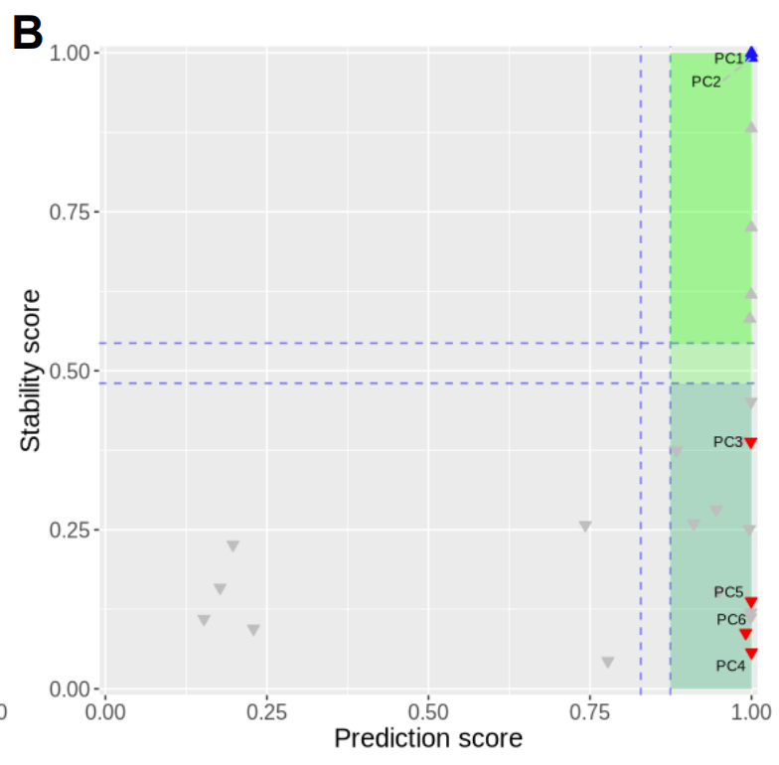
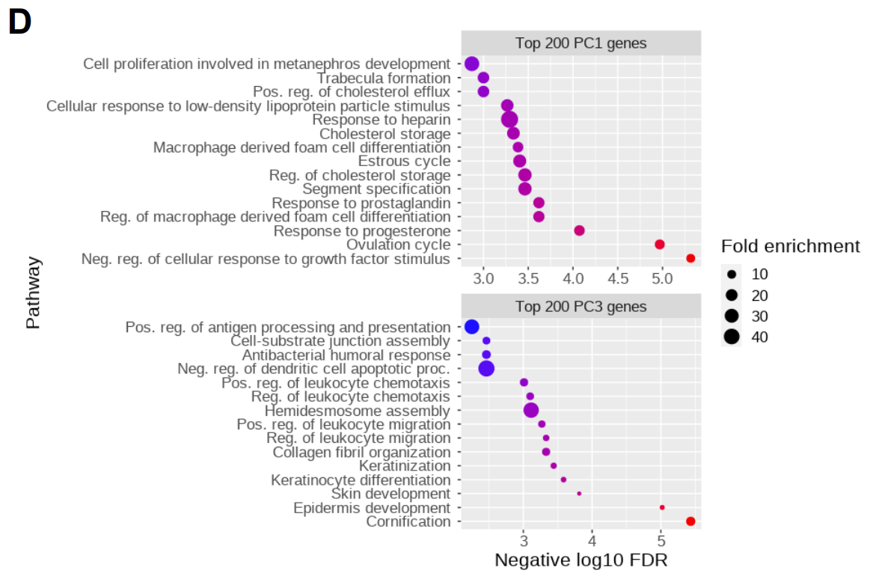
ESR1 vs principal components (PCs)
(Estrogen receptor 1)
PC1 relates to hormonic regulation
PC3 relates to epidermis development
Notes:
For example, we can even use PCs as predictors, here I show the result of using PCs learned on the gene expression data for predicting ESR1. The selection can be interpreted together with PC loadings. For example, PC1 that is selected as the most stable and predictive is related to hormonic regulation by gene enrichment analysis. We know Estrogen is a hormone that is at the central of this pathway, hence this again proves the concept of stability. The unstable PC3, on the other hand, relates to epidermis development. Such instability can also be informative, as here it suggest ESR1’s environment-specific regulatory roles in tumour progression.

Slide 22
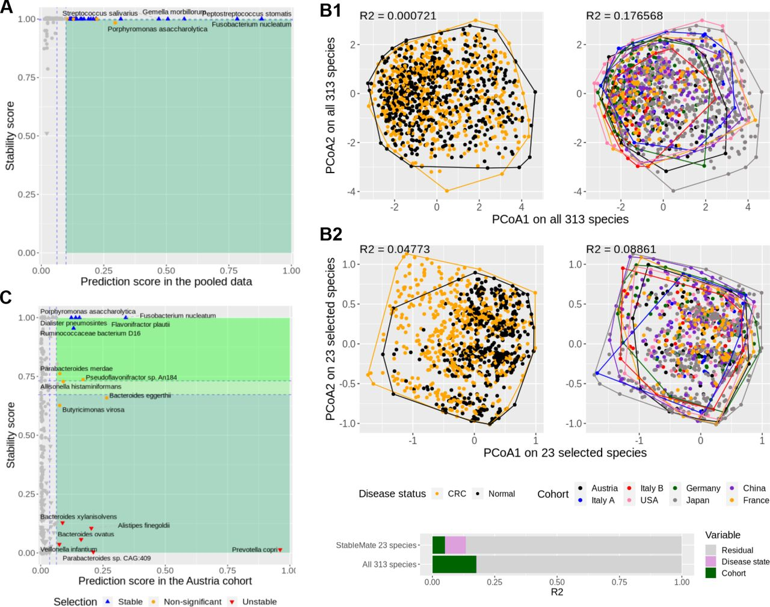
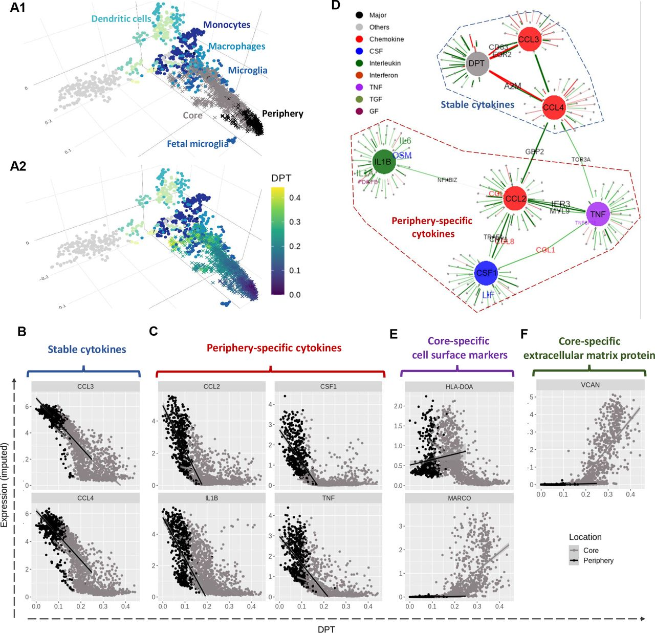
What else?
Metagenomic data: predict colon cancer incidence with fecal microbiome abundance
scRNA-seq data: Characterising cell identity transition of glioblastoma tumour-infiltrating microglia
Github: github.com/meiosis97/StableMate
Deng, Y., Mao, J., Choi, J., & Lê Cao, K. A. (2024) NAR Genomics and Bioinformatics
Notes:
Of course the definition of environments can be very flexible depending on the study context, and I believe in plant, animal, or ecology research the definition can be more natural. In our paper, we have two addition case study on metagenomic data and single-cell RNA-seq data where we used different environment. So if you are interested, please take a look. Thank you

